Slide 1
18-447 Computer Architecture Lecture 25: Memory Latency Tolerance II: Prefetching
Prof. Onur Mutlu
Carnegie Mellon University
Spring 2015, 4/1/2015

Slide 2
Announcements
My office hours moved to 3:40-4:40pm today

Slide 3
Reminder on Assignments
Lab 6 due this Friday (April 3)
C-level simulation of data caches and branch prediction
Homework 6 will be due April 10
Tentative Midterm II date: April 22
The course will continue to move quickly… Keep your pace.
Talk with the TAs and me if you need any help.
We cannot do or debug the assignments for you but we can give you suggestions
My goal is to enable you learn the material
You never know when you will use the principles you learn

Slide 4
Lab Late Days
3 more late days you can use on Lab 6 & 7
Lab 8 will have special treatment

Slide 5
Where We Are in Lecture Schedule
The memory hierarchy
Caches, caches, more caches
Virtualizing the memory hierarchy: Virtual Memory
Main memory: DRAM
Main memory control, scheduling
Memory latency tolerance techniques
Non-volatile memory
Multiprocessors
Coherence and consistency
Interconnection networks
Multi-core issues (e.g., heterogeneous multi-core)

Slide 6
Upcoming Seminar on DRAM (April 3)
April 3, Friday, 11am-noon, GHC 8201
Prof. Moinuddin Qureshi, Georgia Tech
Lead author of “MLP-Aware Cache Replacement”
Architecting 3D Memory Systems
Die stacked 3D DRAM technology can provide low-energy high-bandwidth memory module by vertically integrating several dies within the same chip. (…) In this talk, I will discuss how memory systems can efficiently architect 3D DRAM either as a cache or as main memory. First, I will show that some of the basic design decisions typically made for conventional caches (such as serialization of tag and data access, large associativity, and update of replacement state) are detrimental to the performance of DRAM caches, as they exacerbate hit latency. (…) Finally, I will present a memory organization that allows 3D DRAM to be a part of the OS-visible memory address space, and yet relieves the OS from data migration duties. (…)”

Slide 7
Required Reading
Onur Mutlu, Justin Meza, and Lavanya Subramanian, "The Main Memory System: Challenges and Opportunities" Invited Article in Communications of the Korean Institute of Information Scientists and Engineers (KIISE), 2015.
http://users.ece.cmu.edu/~omutlu/pub/main-memory-system_kiise15.pdf

Slide 8
Tolerating Memory Latency

Slide 9
Cache Misses Responsible for Many Stalls
L2 Misses
512KB L2 cache, 500-cycle DRAM latency, aggressive stream-based prefetcher
Data averaged over 147 memory-intensive benchmarks on a high-end x86 processor model

Slide 10
Memory Latency Tolerance Techniques
Caching [initially by Wilkes, 1965]
Widely used, simple, effective, but inefficient, passive
Not all applications/phases exhibit temporal or spatial locality
Prefetching [initially in IBM 360/91, 1967]
Works well for regular memory access patterns
Prefetching irregular access patterns is difficult, inaccurate, and hardware-intensive
Multithreading [initially in CDC 6600, 1964]
Works well if there are multiple threads
Improving single thread performance using multithreading hardware is an ongoing research effort
Out-of-order execution [initially by Tomasulo, 1967]
Tolerates irregular cache misses that cannot be prefetched
Requires extensive hardware resources for tolerating long latencies
Runahead execution alleviates this problem (as we will see today)

Slide 11
Runahead Execution (I)
A technique to obtain the memory-level parallelism benefits of a large instruction window
When the oldest instruction is a long-latency cache miss:
Checkpoint architectural state and enter runahead mode
In runahead mode:
Speculatively pre-execute instructions
The purpose of pre-execution is to generate prefetches
L2-miss dependent instructions are marked INV and dropped
Runahead mode ends when the original miss returns
Checkpoint is restored and normal execution resumes
Mutlu et al., “Runahead Execution: An Alternative to Very Large Instruction Windows for Out-of-order Processors,” HPCA 2003.

Slide 12
Runahead Example
Perfect Caches:
Load 1 Hit
Load 2 Hit
Compute
Compute
Small Window:
Load 1 Miss
Load 2 Miss
Compute
Stall
Compute
Stall
Miss 1
Miss 2
Runahead:
Load 1 Miss
Load 2 Miss
Load 1 Hit
Load 2 Hit
Compute
Runahead
Compute
Saved Cycles
Miss 1
Miss 2

Slide 13
Runahead Enhancements

Slide 14
Readings
Required
Mutlu et al., “Runahead Execution”, HPCA 2003, Top Picks 2003.
Recommended
Mutlu et al., “Efficient Runahead Execution: Power-Efficient Memory Latency Tolerance,” ISCA 2005, IEEE Micro Top Picks 2006.
Mutlu et al., “Address-Value Delta (AVD) Prediction,” MICRO 2005.
Armstrong et al., “Wrong Path Events,” MICRO 2004.

Slide 15
Limitations of the Baseline Runahead Mechanism
Energy Inefficiency
A large number of instructions are speculatively executed
Efficient Runahead Execution [ISCA’05, IEEE Micro Top Picks’06]
Ineffectiveness for pointer-intensive applications
Runahead cannot parallelize dependent L2 cache misses
Address-Value Delta (AVD) Prediction [MICRO’05]
Irresolvable branch mispredictions in runahead mode
Cannot recover from a mispredicted L2-miss dependent branch
Wrong Path Events [MICRO’04]

Slide 16
The Problem: Dependent Cache Misses
Runahead execution cannot parallelize dependent misses
wasted opportunity to improve performance
wasted energy (useless pre-execution)
Runahead performance would improve by 25% if this limitation were ideally overcome
Runahead: Load 2 is dependent on Load 1
Cannot Compute Its Address!
Load 1 Miss
Load 2
INV
Load 1 Hit
Load 2 Miss
Compute
Runahead
Miss 1
Miss 2

Slide 17
Parallelizing Dependent Cache Misses
Idea: Enable the parallelization of dependent L2 cache misses in runahead mode with a low-cost mechanism
How: Predict the values of L2-miss address (pointer) loads
Address load: loads an address into its destination register, which is later used to calculate the address of another load
as opposed to data load
Read:
Mutlu et al., “Address-Value Delta (AVD) Prediction,” MICRO 2005.

Slide 18
Parallelizing Dependent Cache Misses
Cannot Compute Its Address!
Load 1 Miss
Load 2 INV
Load 1 Hit
Load 2 Miss
Compute
Runahead
Miss 1
Miss 2
Value Predicted
Can Compute Its Address
Load 1 Miss
Load 2
Miss
Load 1 Hit
Load 2 Hit
Saved Speculative Instructions
Compute
Runahead
Saved Cycles
Miss 1
Miss 2
Notes:
As I showed before, traditional runahead execution cannot parallelize dependent cache misses due to load 1 and load 2, because load 2 cannot compute its address in runahead mode. However, if the value of Load 1 is predicted, Load 2 would be able to compute its address and it would generate its miss in runahead mode.

Slide 19
AVD Prediction [MICRO’05]
Address-value delta (AVD) of a load instruction defined as:
AVD = Effective Address of Load – Data Value of Load
For some address loads, AVD is stable
An AVD predictor keeps track of the AVDs of address loads
When a load is an L2 miss in runahead mode, AVD predictor is consulted
If the predictor returns a stable (confident) AVD for that load, the value of the load is predicted
Predicted Value = Effective Address – Predicted AVD
Notes:
Say that predictor does not need to be large!

Slide 20
Why Do Stable AVDs Occur?
Regularity in the way data structures are
allocated in memory AND
traversed
Two types of loads can have stable AVDs
Traversal address loads
Produce addresses consumed by address loads
Leaf address loads
Produce addresses consumed by data loads

Slide 21
Traversal Address Loads
Regularly-allocated linked list:
A traversal address load loads the pointer to next node:
node = node→next
A
AVD = Effective Addr – Data Value
A+k
Effective Addr
Data Value
AVD
A+2k
A
A+k
-k
...
A+k
A+2k
-k
A+3k
A+2k
A+3k
-k
Striding data value
Stable AVD

Slide 22
Leaf Address Loads
Sorted dictionary in parser: Nodes point to strings (words) String and node allocated consecutively
Dictionary looked up for an input word.
A leaf address load loads the pointer to the string of each node:
lookup (node, input) { // ... ptr_str = node→string; m = check_match(ptr_str, input); // … }
A+k
B+k
A
C+k
node
B
C
string
AVD = Effective Addr – Data Value
D+k
E+k
F+k
G+k
Effective Addr
Data Value
AVD
A+k
A
k
D
E
F
G
C+k
C
k
F+k
F
k
No stride!
Stable AVD

Slide 23
Identifying Address Loads in Hardware
Insight:
If the AVD is too large, the value that is loaded is likely not an address
Only keep track of loads that satisfy:
-MaxAVD ≤ AVD ≤ +MaxAVD
This identification mechanism eliminates many loads from consideration for prediction
No need to value- predict the loads that will not generate addresses
Enables the predictor to be small

Slide 24
Performance of AVD Prediction
runahead
14.3%
15.5%
Notes:
16-entry predictor, baseline: runahead processor
In contrast, a 16-entry stride value predictor reduces exec time by only 2.7% and exec inst by 3.5%
A 4K-entry stride VP reduces exec time by 4.7% and exec inst by 6.1%

Slide 25
Prefetching

Slide 26
Outline of Prefetching Lecture(s)
Why prefetch? Why could/does it work?
The four questions
What (to prefetch), when, where, how
Software prefetching
Hardware prefetching algorithms
Execution-based prefetching
Prefetching performance
Coverage, accuracy, timeliness
Bandwidth consumption, cache pollution
Prefetcher throttling
Issues in multi-core (if we get to it)

Slide 27
Prefetching
Idea: Fetch the data before it is needed (i.e. pre-fetch) by the program
Why?
Memory latency is high. If we can prefetch accurately and early enough we can reduce/eliminate that latency.
Can eliminate compulsory cache misses
Can it eliminate all cache misses? Capacity, conflict?
Involves predicting which address will be needed in the future
Works if programs have predictable miss address patterns

Slide 28
Prefetching and Correctness
Does a misprediction in prefetching affect correctness?
No, prefetched data at a “mispredicted” address is simply not used
There is no need for state recovery
In contrast to branch misprediction or value misprediction

Slide 29
Basics
In modern systems, prefetching is usually done in cache block granularity
Prefetching is a technique that can reduce both
Miss rate
Miss latency
Prefetching can be done by
hardware
compiler
programmer

Slide 30
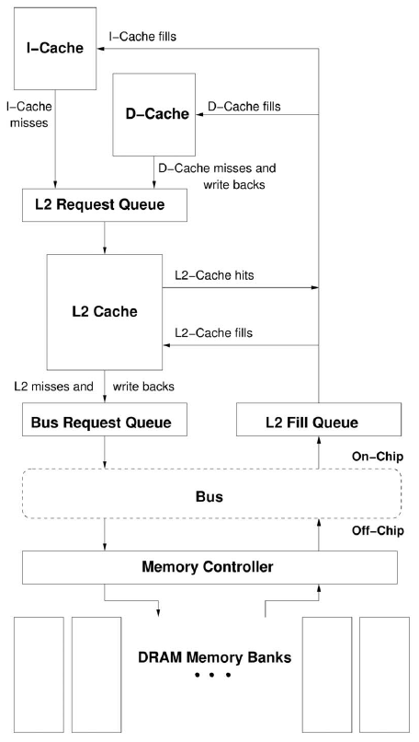
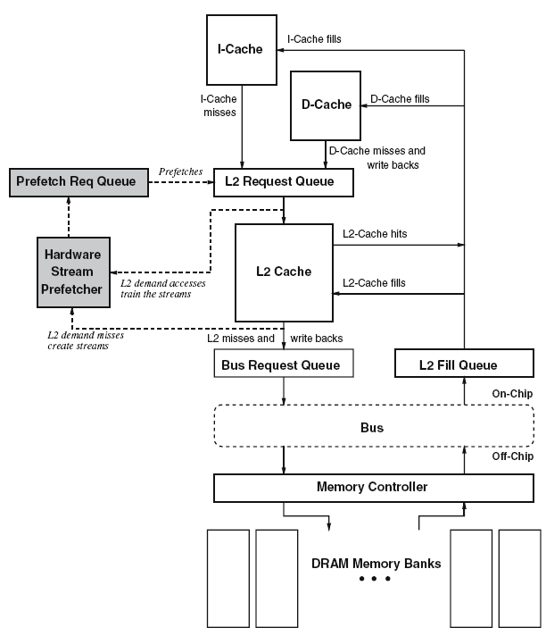
How a HW Prefetcher Fits in the Memory System

Slide 31
Prefetching: The Four Questions
What
What addresses to prefetch
When
When to initiate a prefetch request
Where
Where to place the prefetched data
How
Software, hardware, execution-based, cooperative

Slide 32
Challenges in Prefetching: What
What addresses to prefetch
Prefetching useless data wastes resources
Memory bandwidth
Cache or prefetch buffer space
Energy consumption
These could all be utilized by demand requests or more accurate prefetch requests
Accurate prediction of addresses to prefetch is important
Prefetch accuracy = used prefetches / sent prefetches
How do we know what to prefetch
Predict based on past access patterns
Use the compiler’s knowledge of data structures
Prefetching algorithm determines what to prefetch

Slide 33
Challenges in Prefetching: When
When to initiate a prefetch request
Prefetching too early
Prefetched data might not be used before it is evicted from storage
Prefetching too late
Might not hide the whole memory latency
When a data item is prefetched affects the timeliness of the prefetcher
Prefetcher can be made more timely by
Making it more aggressive: try to stay far ahead of the processor’s access stream (hardware)
Moving the prefetch instructions earlier in the code (software)

Slide 34
Challenges in Prefetching: Where (I)
Where to place the prefetched data
In cache
+ Simple design, no need for separate buffers
-- Can evict useful demand data → cache pollution
In a separate prefetch buffer
+ Demand data protected from prefetches → no cache pollution
-- More complex memory system design
- Where to place the prefetch buffer
- When to access the prefetch buffer (parallel vs. serial with cache)
- When to move the data from the prefetch buffer to cache
- How to size the prefetch buffer
- Keeping the prefetch buffer coherent
Many modern systems place prefetched data into the cache
Intel Pentium 4, Core2’s, AMD systems, IBM POWER4,5,6, …

Slide 35
Challenges in Prefetching: Where (II)
Which level of cache to prefetch into?
Memory to L2, memory to L1. Advantages/disadvantages?
L2 to L1? (a separate prefetcher between levels)
Where to place the prefetched data in the cache?
Do we treat prefetched blocks the same as demand-fetched blocks?
Prefetched blocks are not known to be needed
With LRU, a demand block is placed into the MRU position
Do we skew the replacement policy such that it favors the demand-fetched blocks?
E.g., place all prefetches into the LRU position in a way?

Slide 36
Challenges in Prefetching: Where (III)
Where to place the hardware prefetcher in the memory hierarchy?
In other words, what access patterns does the prefetcher see?
L1 hits and misses
L1 misses only
L2 misses only
Seeing a more complete access pattern:
+ Potentially better accuracy and coverage in prefetching
-- Prefetcher needs to examine more requests (bandwidth intensive, more ports into the prefetcher?)

Slide 37
Challenges in Prefetching: How
Software prefetching
ISA provides prefetch instructions
Programmer or compiler inserts prefetch instructions (effort)
Usually works well only for “regular access patterns”
Hardware prefetching
Hardware monitors processor accesses
Memorizes or finds patterns/strides
Generates prefetch addresses automatically
Execution-based prefetchers
A “thread” is executed to prefetch data for the main program
Can be generated by either software/programmer or hardware

Slide 38
Software Prefetching (I)
Idea: Compiler/programmer places prefetch instructions into appropriate places in code
Mowry et al., “Design and Evaluation of a Compiler Algorithm for Prefetching,” ASPLOS 1992.
Prefetch instructions prefetch data into caches
Compiler or programmer can insert such instructions into the program

Slide 39
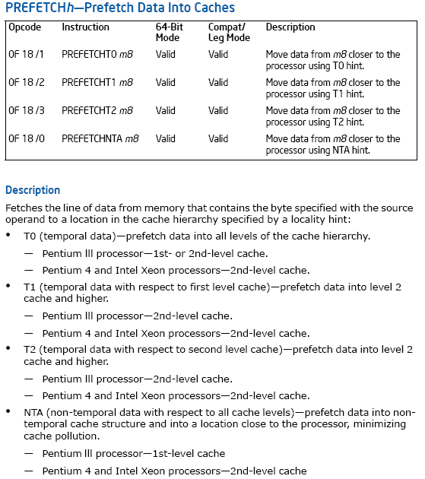
X86 PREFETCH Instruction
microarchitecture
dependent
specification
different instructions
for different cache
levels

Slide 40
Software Prefetching (II)
Can work for very regular array-based access patterns. Issues:
-- Prefetch instructions take up processing/execution bandwidth
How early to prefetch? Determining this is difficult
-- Prefetch distance depends on hardware implementation (memory latency, cache size, time between loop iterations) → portability?
-- Going too far back in code reduces accuracy (branches in between)
Need “special” prefetch instructions in ISA?
Alpha load into register 31 treated as prefetch (r31==0)
PowerPC dcbt (data cache block touch) instruction
-- Not easy to do for pointer-based data structures
for (i=0; i<N; i++) {
__prefetch(a[i+8]);
__prefetch(b[i+8]);
sum += a[i]*b[i];
}
while (p) {
__prefetch(p→next);
work(p→data);
p = p→next;
}
while (p) {
__prefetch(p→next→next→next);
work(p→data);
p = p→next;
}
Which one is better?

Slide 41
Software Prefetching (III)
Where should a compiler insert prefetches?
Prefetch for every load access?
Too bandwidth intensive (both memory and execution bandwidth)
Profile the code and determine loads that are likely to miss
What if profile input set is not representative?
How far ahead before the miss should the prefetch be inserted?
Profile and determine probability of use for various prefetch distances from the miss
What if profile input set is not representative?
Usually need to insert a prefetch far in advance to cover 100s of cycles of main memory latency → reduced accuracy

Slide 42
Hardware Prefetching (I)
Idea: Specialized hardware observes load/store access patterns and prefetches data based on past access behavior
Tradeoffs:
+ Can be tuned to system implementation
+ Does not waste instruction execution bandwidth
-- More hardware complexity to detect patterns
- Software can be more efficient in some cases

Slide 43
Next-Line Prefetchers
Simplest form of hardware prefetching: always prefetch next N cache lines after a demand access (or a demand miss)
Next-line prefetcher (or next sequential prefetcher)
Tradeoffs:
+ Simple to implement. No need for sophisticated pattern detection
+ Works well for sequential/streaming access patterns (instructions?)
-- Can waste bandwidth with irregular patterns
-- And, even regular patterns:
- What is the prefetch accuracy if access stride = 2 and N = 1?
- What if the program is traversing memory from higher to lower addresses?
- Also prefetch “previous” N cache lines?

Slide 44
Stride Prefetchers
Two kinds
Instruction program counter (PC) based
Cache block address based
Instruction based:
Baer and Chen, “An effective on-chip preloading scheme to reduce data access penalty,” SC 1991.
Idea:
Record the distance between the memory addresses referenced by a load instruction (i.e. stride of the load) as well as the last address referenced by the load
Next time the same load instruction is fetched, prefetch last address + stride

Slide 45
Instruction Based Stride Prefetching
What is the problem with this?
How far can the prefetcher get ahead of the demand access stream?
Initiating the prefetch when the load is fetched the next time can be too late
Load will access the data cache soon after it is fetched!
Solutions:
Use lookahead PC to index the prefetcher table (decouple frontend of the processor from backend)
Prefetch ahead (last address + N*stride)
Generate multiple prefetches
Load Inst. | Last Address | Last | Confidence
PC (tag) | Referenced | Stride
……. | ……. | ……
Load
Inst
PC

Slide 46
Cache-Block Address Based Stride Prefetching
Can detect
A, A+N, A+2N, A+3N, …
Stream buffers are a special case of cache block address based stride prefetching where N = 1
Address tag | Stride | Control/Confidence
……. | ……
Block
address

Slide 47
Stream Buffers (Jouppi, ISCA 1990)
Each stream buffer holds one stream of sequentially prefetched cache lines
On a load miss check the head of all stream buffers for an address match
if hit, pop the entry from FIFO, update the cache with data
if not, allocate a new stream buffer to the new miss address (may have to recycle a stream buffer following LRU policy)
Stream buffer FIFOs are continuously topped-off with subsequent cache lines whenever there is room and the bus is not busy
FIFO
FIFO
DCache
Memory interface
FIFO
FIFO
Jouppi, “Improving Direct-Mapped Cache Performance by the Addition of a Small Fully-Associative Cache and Prefetch Buffers,” ISCA 1990.

Slide 48
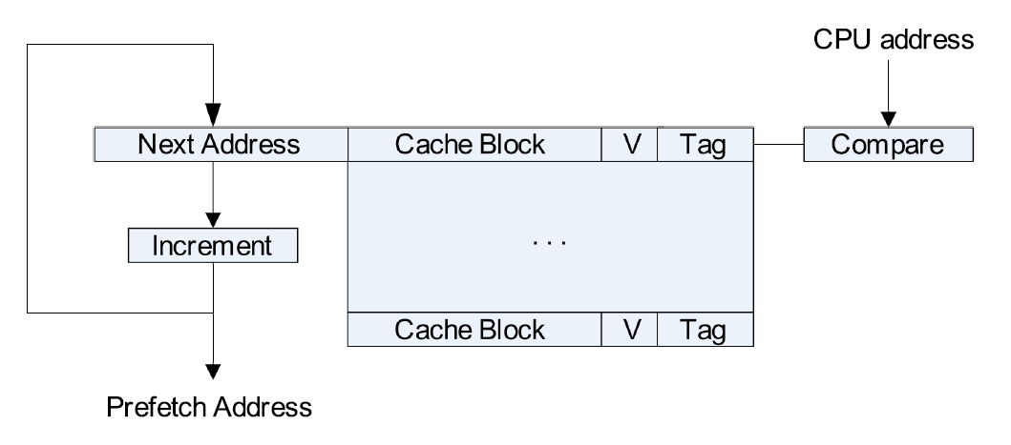
Stream Buffer Design

Slide 49
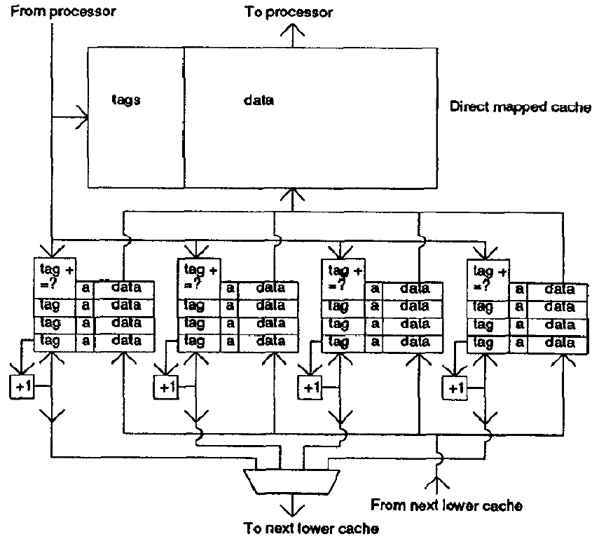
Stream Buffer Design

Slide 50
Prefetcher Performance (I)
Accuracy (used prefetches / sent prefetches)
Coverage (prefetched misses / all misses)
Timeliness (on-time prefetches / used prefetches)
Bandwidth consumption
Memory bandwidth consumed with prefetcher / without prefetcher
Good news: Can utilize idle bus bandwidth (if available)
Cache pollution
Extra demand misses due to prefetch placement in cache
More difficult to quantify but affects performance

Slide 51
Prefetcher Performance (II)
Prefetcher aggressiveness affects all performance metrics
Aggressiveness dependent on prefetcher type
For most hardware prefetchers:
Prefetch distance: how far ahead of the demand stream
Prefetch degree: how many prefetches per demand access
Access Stream
Prefetch Degree
X
X+1
Predicted Stream
Predicted Stream
1 2 3
P_{max}
P
P_{max}
P_{max}
P_{max}
Very Conservative
Middle of the Road
Prefetch Distance
Very Aggressive

Slide 52
Prefetcher Performance (III)
How do these metrics interact?
Very Aggressive Prefetcher (large prefetch distance & degree)
Well ahead of the load access stream
Hides memory access latency better
More speculative
+ Higher coverage, better timeliness
-- Likely lower accuracy, higher bandwidth and pollution
Very Conservative Prefetcher (small prefetch distance & degree)
Closer to the load access stream
Might not hide memory access latency completely
Reduces potential for cache pollution and bandwidth contention
+ Likely higher accuracy, lower bandwidth, less polluting
-- Likely lower coverage and less timely

Slide 53
Prefetcher Performance (IV)

Slide 54
Prefetcher Performance (V)
Srinath et al., “Feedback Directed Prefetching: Improving the Performance and Bandwidth-Efficiency of Hardware Prefetchers“, HPCA 2007.
↓48%
↓ 29%

Slide 55
Feedback-Directed Prefetcher Throttling (I)
Idea:
Dynamically monitor prefetcher performance metrics
Throttle the prefetcher aggressiveness up/down based on past performance
Change the location prefetches are inserted in cache based on past performance
High Accuracy
Med Accuracy
Low Accuracy
Not-Late
Late
Not-Poll
Polluting
Not-Poll
Decrease
Polluting
Increase
Late
Decrease
Not-Late
Decrease
Increase
No Change

Slide 56
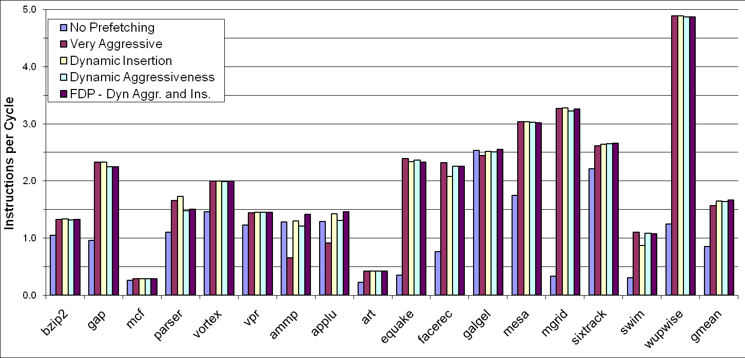
Feedback-Directed Prefetcher Throttling (II)
Srinath et al., “Feedback Directed Prefetching: Improving the Performance and Bandwidth-Efficiency of Hardware Prefetchers“, HPCA 2007.
Srinath et al., “Feedback Directed Prefetching: Improving the Performance and Bandwidth-Efficiency of Hardware Prefetchers“, HPCA 2007.
↑11%
↑13%

Slide 57
How to Prefetch More Irregular Access Patterns?
Regular patterns: Stride, stream prefetchers do well
More irregular access patterns
Indirect array accesses
Linked data structures
Multiple regular strides (1,2,3,1,2,3,1,2,3,…)
Random patterns?
Generalized prefetcher for all patterns?
Correlation based prefetchers
Content-directed prefetchers
Precomputation or execution-based prefetchers

